Slide 1
EMPLOYEE TRAINING
UNDERSTANDING YOUR PROGRAMME BENEFITS
HOW TO MAKE THE MOST OUT OF YOUR INTERNATIONAL SOS SUBSCRIPTION

Slide 2
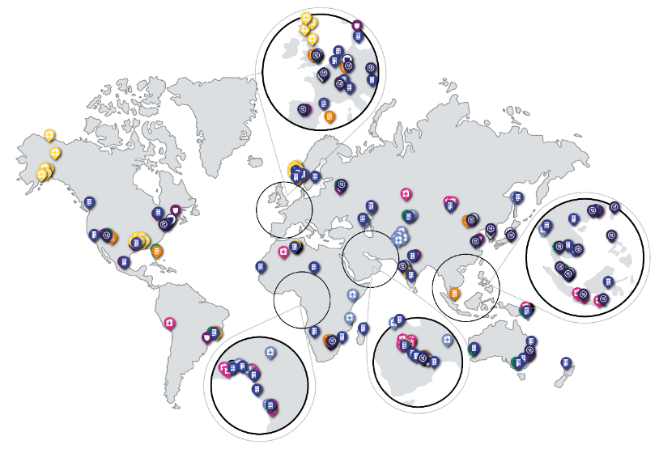
HELPING YOUR PEOPLE
WHEREVER THEY ARE AND WHEREVER THEY ARE GOING
AT A GLANCE
1,000 locations in 85 countries
27 Assistance Centres
10,000 employees
99 languages
5,200 medical professionals
56 clinics
Access to 3,200 security specialists
90,000 providers in 227 countries

Slide 3
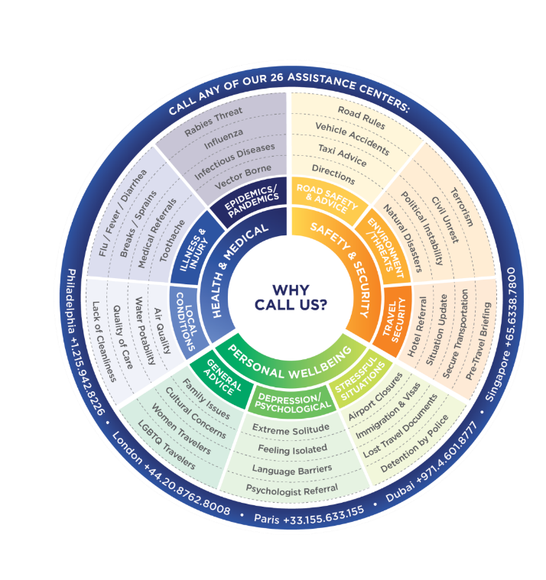
WHY SHOULD I CALL INTERNATIONAL SOS?
LOCAL MEDICAL, SECURITY AND MENTAL WELLBEING EXPERTISE PROVIDED GLOBALLY IN ANY LANGUAGE, ANYTIME 24/7/365.
No matter how small your concern may feel, when in doubt, call International SOS.
FOR ALL LOCATIONS VISIT, INTERNATIONALSOS.COM/LOCATIONS

Slide 4
PRE-DEPARTURE
HELPING YOU
WHEREVER YOU ARE AND WHEREVER YOU’RE GOING
WHILST ABROAD
IN AN EMERGENCY

Slide 5
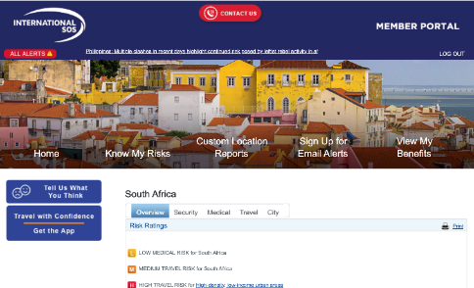
PRE-DEPARTURE
Researching your destination
Before booking & as part of approval process
Download the Assistance App
or at
app.internationalsos.com

Slide 6
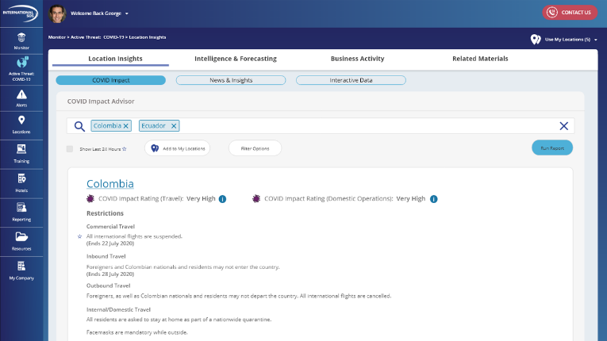
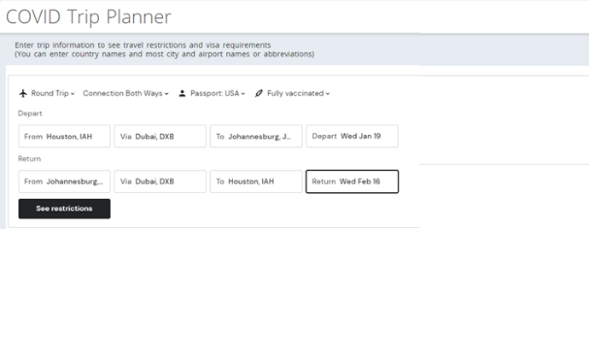
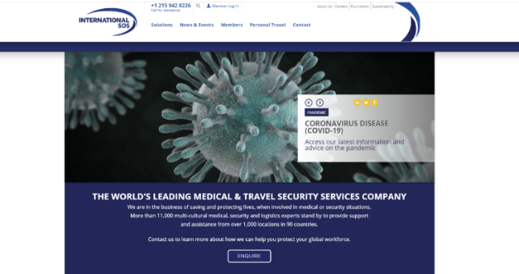
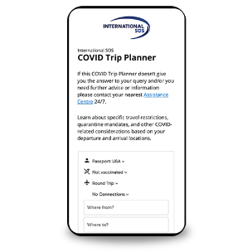
COVID TRIP PLANNER
AVAILABLE IN ASSISTANCE APP, PORTAL, PRE-TRIP ADVISORY
Assists you in avoiding trip delays, unnecessary quarantine time, and other disturbances.
COVID Trip Planner lets you understand travel restrictions and requirements for specific trips
based on:
A traveller's personal passport and vaccination status
Travel and entry/exit rules by destination
Quarantine mandates and other COVID-19 related considerations

Slide 7
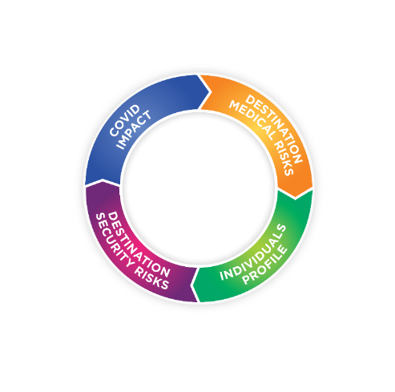
PREPARATION IT’S NOT JUST ABOUT THE DESTINATION RISK
CLOSED BORDERS
COVID BURDEN ON HEALTH & COUNTRY INFRASTRUCTURE
POOR MEDICAL CARE
INFECTIOUS DISEASES
AIR QUALITY
HOTEL
CYBER
PETTY CRIME
ROAD SAFETY ISSUES
TERRORISM & CIVIL UNREST
NATURAL DISASTER
LGBTIQ
PRE EXISTING MEDICAL CONCERNS
MENTAL WELLBEING
FEMALE TRAVELLER
Notes:
Syaz: 4 quadrants of risks, medical, security, individual, covid

Slide 8
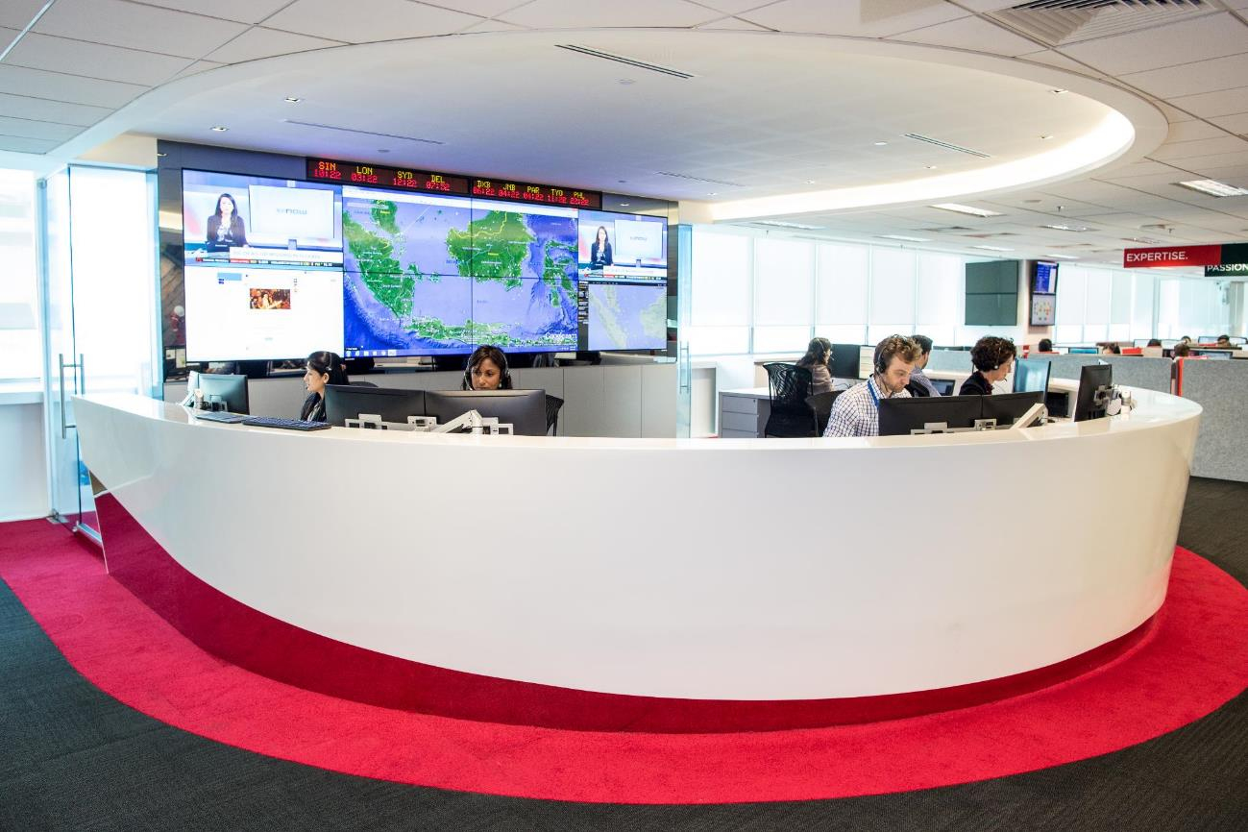
PRE-DEPARTURE
Preparing to travel
Pre trip advisories, more questions?

Slide 9
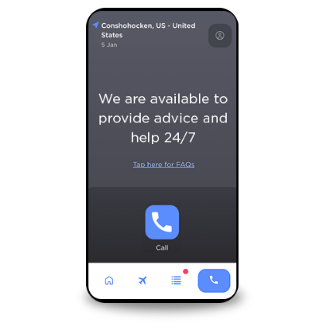
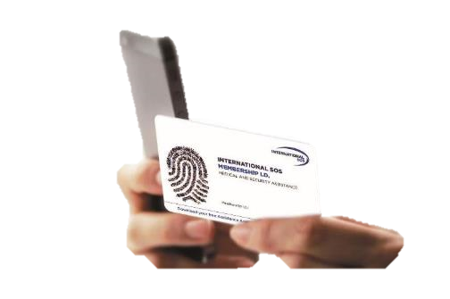
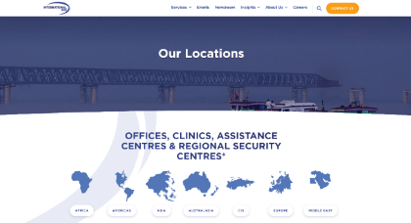
WHILST ABROAD
How to connect to our Assistance Centre
Call for information, advice & referrals

Slide 10
WHILST ABROAD
Contact us anytime with questions
Call for information, advice & referrals

Slide 11
WHILST ABROAD
Emotional support
YOUR emotional wellbeing is also supported through our assistance centres by our partner workplace options
Travelling through time zones – ‘jetlag’
Lack of work-life balance or work load
Poor sleep and diet
Organisational structure and culture change
Isolation, disconnected from support, being far away from home
01
EMOTIONAL SUPPORT
Consistent and globally delivered emotional support through International SOS Assistance Centers
02
OPTIONS
Counselling via phone, video-call or face-to-face sessions are available
03
TREATMENT PLANS
Allow for 5 sessions per member, per year
02

Slide 12
IN AN EMERGENCY
IN AN EMERGENCY
LESS THAN 1% OF ALL OUR CASES RESULT IN AN EMERGENCY
BUT IF THE UNTHINKABLE HAPPENS
WE MONITOR YOUR CONDITION AND GIVE ADVICE.
WE MONITOR YOUR CONDITION AND GIVE ADVICE.
WE HANDLE ALL LOGISTICS.
WE EVACUATE YOU TO A CENTRE OF MEDICAL EXCELLENCE.
WE EVACUATE YOU TO A SAFE AREA.
WE HELP YOU STAY IN TOUCH WITH YOUR FAMILY.
WE HELP YOU STAY IN TOUCH WITH YOUR FAMILY.
WE KEEP YOU INFORMED EVERY STEP OF THE WAY.
WE KEEP YOU INFORMED EVERY STEP OF THE WAY.
WE COORDINATE PAYMENT OF MEDICAL FEES WHEN APPROVED.
WE COORDINATE PAYMENT OF MEDICAL FEES WHEN APPROVED.
WE ORGANISE REPATRIATION OF MORTAL REMAINS.

Slide 13
IN AN EMERGENCY
alerts
Information and Advice to you in an event, based on your location

Slide 14
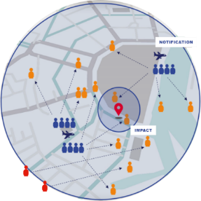
IN AN EMERGENCY
Auto emergency check in
EMPLOYEES CONTACTED AUTOMATICALLY VIA 2 WAY COMMS
SECURITY SPECIAL ADVISORY
IMPACTED USERS AUTO CHECKED IN
APP USERS IN IMPACT AREA IDENTIFIED
MANAGER VIEWS IMPACTED USERS IN TRACKER

Slide 15
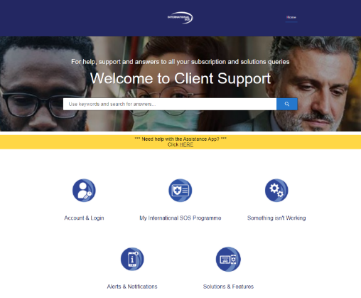
Handy resource
Bookmark this troubleshooting page
https://clientsupport.internationalsos.com/s/

Slide 16
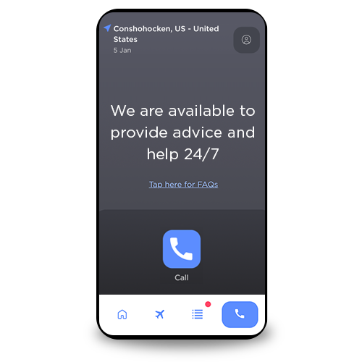
Q&A
Download the Assistance App
Notes:
Bec to moderate

