Slide 1
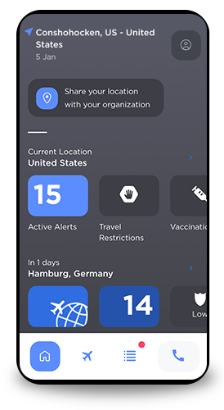
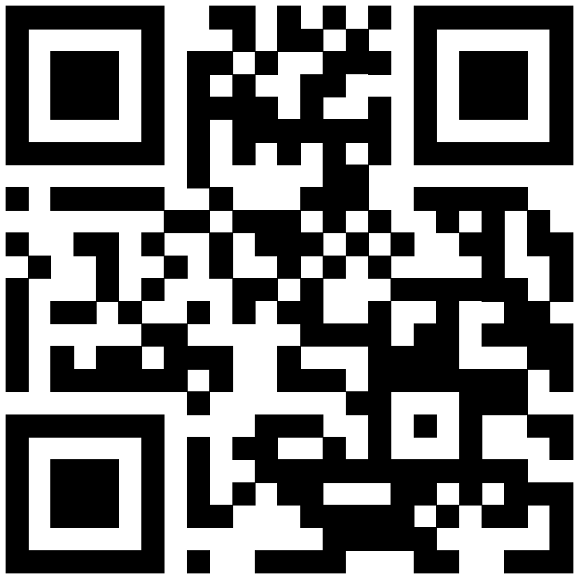
International SOS
ASSISTANCE APP
Stay informed, healthy and safe while travelling at home and abroad
Use the International SOS Assistance App for medical and security support, whether at home or abroad:
Receive support from an International SOS Assistance Centre, 24/7, from anywhere in the world – with the tap of a button.
2. Stay safe and informed with location-based alerts, local travel restrictions, and Auto-Emergency Check-In.
3. Receive real-time alerts based on your location; plus, access up-to-date COVID-19 travel restriction information for anywhere in the world.
Learn more: https://www.internationalsos.com/subscriber/assistance-app
Membership ID Number:
Add logo here
internationalsos.com

